Slide 1
NAPPO Advisory Management Committee (AMC) and the NAPPO Work Program
October 23, 2024

Slide 2
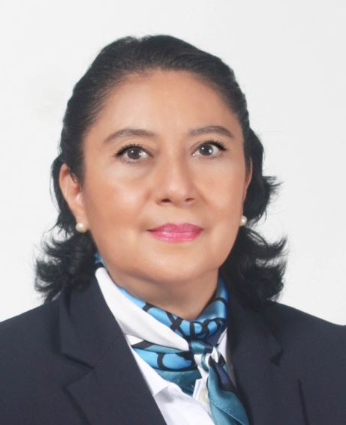
Contact Your Country AMC Member
Tanya Staffen Canadian Food Inspection Agency (CFIA) Email: Tanya.Staffen@inspection.gc.ca
Stephanie Dubon
Plant Protection and Quarantine
Email: Stephanie.M.Dubon@usda.gov
Ana Lilia Montealegre
SENASICA-SADER
Email: Ana.Montealegre@senasica.gob.mx

Slide 3
Overview
Learn more about the AMC
2024 Accomplishments
Looking ahead into 2025
How the AMC contributed to the 2024 and 2025 NAPPO Work Programs
2024 Call for Projects and its outcomes

Slide 4
NAPPO Governance
Executive Committee (EC)
NAPPO Secretariat
Industry Advisory Group (IAG)
Advisory and Management Committee (AMC)

Slide 5
About the NAPPO AMC
Advisory and Management Committee (AMC)/ El Comité Consultivo y de Manejo (CCM)
At least one representative from each NPPO (Canada, U.S., Mexico).
The NAPPO Chief Scientist (CS) and Technical Director (TD) are also AMC members.

Slide 6
AMC Roles and Responsibilities
Discusses and makes recommendations to the EC on strategic, project-related, and logistic issues that may impact NAPPO operations and deliverables.
Identifies and supports expert group members
Liaises between the Secretariat and EC members, experts, industry, and other stakeholders in their country
Provides:
day-to-day oversight of NAPPO
expert input and direction on financial, programmatic, and operational issues at NAPPO
strategic direction to the EC
Assists in management and delivery of the NAPPO work program

Slide 7
AMC Accomplishments in 2024
January: NAPPO-EPPO Meeting
February: Consultation on Seeds Specification
March: NAPPO standards adopted - DD 5, Guidance doc on ISPM 25
April: Provided speakers for CPM Side Session on systems approaches and Science Session on e-Commerce
June: Call for Projects and its outcomes
Long-term:
Assisted with staffing process for the new CS
Prepared for the 2024 Annual Meeting
Identified and supported experts for NAPPO projects
Shaped the 2024 NAPPO Work Program

Slide 8
AMC – Looking ahead into 2025
January: NAPPO-EPPO Meeting
Prepare for the 2025 Annual Meeting
Identify and support experts for NAPPO projects
Shape the 2025 NAPPO Work Program
Assist with review and writing of the NAPPO newsletter

Slide 9
NAPPO Work Program
Updated and approved annually by the Executive Committee.
Typically has 15 +/- active projects.
Project work is conducted and developed by Expert Groups (EGs) and managed by the AMC and Secretariat.
About 70% of EGs have industry members.
https://nappo.org/english/governance/work-program

Slide 10
Examples of NAPPO Projects – www.NAPPO.org
Regional Standards for Phytosanitary Measures | 41 RSPMs as of October 2024
Ongoing Projects | Phytosanitary Alert System – www.pestalerts.org Official Pest Reports and Emerging Pest Alerts
Workshops and Symposia | Implementation of ISPM 15 in the Americas (2016) International Symposium on Risk-Based Sampling (2017) Implementation of ISPM 38 in the Americas (2019)
Science and Technology documents | ST-8: Contaminating organisms affecting trade in wood commodities and forestry products (2021)
Position document | P-7: Asian gypsy moth (AGM) specified risk periods in Japan, Russia, Republic of Korea, and China (2021)

Slide 11
2024 NAPPO Call for Projects
First step in the NAPPO standard setting process
Topics can be new standards, revisions to standards, workshops, etc.
Open May - June 2024
NAPPO Advisory Management Committee reviewed 4 projects received and made recommendations to the Executive Committee for the 2025 Work Program

Slide 12
How are projects prioritized?
Linkage to NPPO mission and strategic priorities
Alignment with regional strategic priorities
Harmonization value for North America
Focus on pests of concern to member countries
Availability of technical and scientific expertise
“Completeness”, including resources

Slide 13
NAPPO project life cycle
New project submitted
EG develops project
Country consultation
Project ranking and approval
EC approves completed project

Slide 14
NAPPO Expert Groups
Subject matter experts from government or appointed by government
Experts from industry (identified by the IAG; appointed by the AMC)
Experts from academia and non-governmental organizations

Slide 15
NAPPO Expert Groups
EG Chair and Vice-Chair
-Government
-Industry
-States
-Academia
-Government
-Industry
-States
-Academia
Observers
Ad-hoc members
-Government
-Industry
-Provinces
-Academia

Slide 16
Questions?

