Slide 1

The NAPPO Work Program –Process and Overview of the 2025/2026 NAPPO Work Program
Alonso Suazo
NAPPO Technical Director

Slide 2

What is the NAPPO Work Program?
Compilation of all NAPPO projects approved by the Executive Committee and executed by the NAPPO expert groups, the Advisory and Management Committee, and the NAPPO Secretariat.
13-18 projects per year
Most expert groups have industry participation.

Slide 3
Examples of NAPPO Projects– www.NAPPO.org
Regional Standards for Phytosanitary Measures | 41 RSPMs as of October 2025.
Phytosanitary Alert System – www.pestalerts.org | Official Pest Reports Emerging Pest Alerts
Workshops and Symposia | Implementation of ISPM 15 in the Americas (2016) International Symposium on Risk-Based Sampling (2017) Implementation of ISPM 38 in the Americas (2019)
Science and Technology documents | ST-8: Contaminating organisms affecting trade in wood commodities and forestry products
Position document | P-7: Asian gypsy moth (AGM) specified risk periods in Japan, Russia, Republic of Korea, and China (2021)
Scientific publications | Harmonization of detection protocols for the identification of ToBRFV in tomato and pepper seeds.

Slide 4
How are Projects Included in the NAPPO Work Program?
Call for PP
Submission of PP
Screening and Prioritization by AMC
PP approval by the Executive Committee
Approved projects added to the WP.
WP approved by EC
Project proposal (PP) submission and approval
Every 2 years but not in 2026. However, stakeholders are encouraged to submit proposals
New WP approved in the October Executive Committee Meeting

Slide 5
Submitting new projects to NAPPO
Who can submit? Government, states, industry; any stakeholder
  no funding of research projects per se
How? NAPPO posts the project proposal template on its website; coordinate with your country’s AMC member
When? During the call for proposals every 2 years. Note a new project can be submitted to NAPPO anytime there is an issue that is important to the NAPPO region.

Slide 6
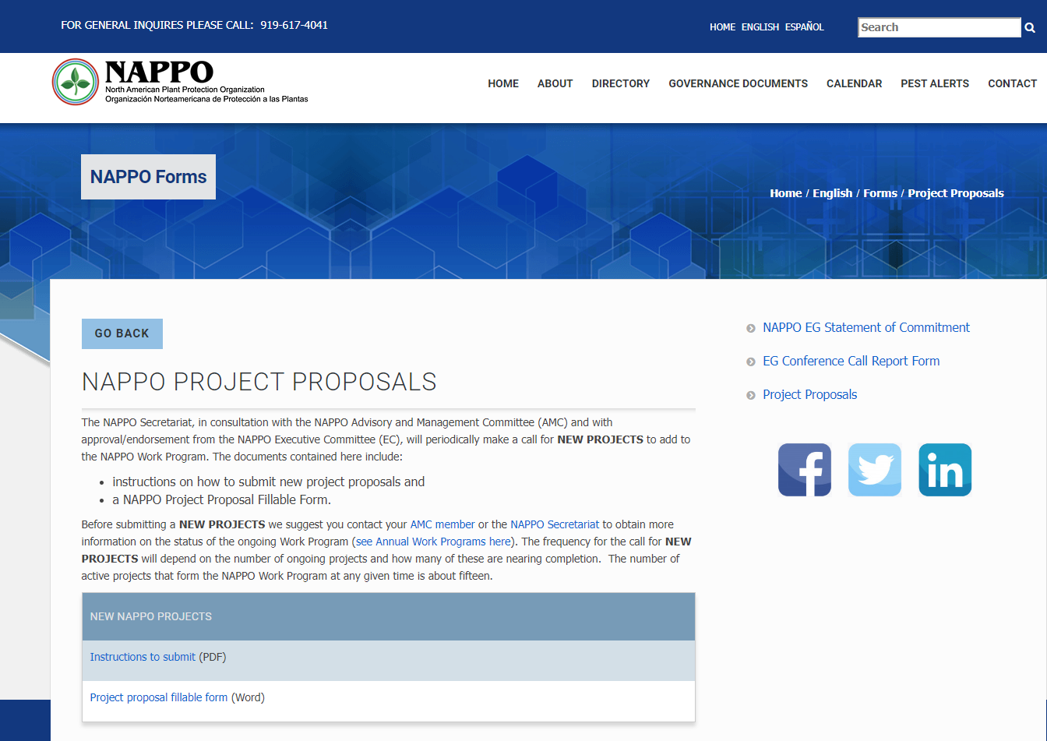
Project proposal overview
Instructions to submit project proposals
Downloadable forms to submit project proposals

Slide 7
Submitting new projects to NAPPO
How are projects prioritized?
  Linkage to National Plant Protection Organization (NPPO) mission and its strategic priorities
  Alignment with regional strategic priorities and the NAPPO strategic plan.
  Harmonization value for North America
  Focus on pests of concern to member countries
  Availability of technical and scientific expertise
  “Completeness”, including resources

Slide 8
Common problems with project proposals
Project is too broad or too large and not within the resource constraints of NAPPO and its member countries (not feasible)
Project does not align with the mandate and authority of the NPPO
Project has implications/sensitivities which may not be understood by the project proponent
Project is requesting funding from NAPPO for research, but is not a NAPPO project with NAPPO expert members

Slide 9
2025 Work Program
8 Technical projects:
  Alternatives to Methyl Bromide
  Risk associated with different wood packaging materials
  Revision of RSPM 26 (Certification of commercial arthropod biological control agents or non-apis pollinators moving into NAPPO member countries)
  Forestry: Testing heat treatment dose for wood product pests
  Emergency response for Phthorimaea absoluta (Tuta absoluta) in the NAPPO region.
  Revision of RSPM 8 (Authorization of individuals to issue phytosanitary certificates).
  RSPM 42 (New RSPM on Use of systems approaches for phytosanitary certification of seeds)-PAUSED until Fall 2026
  The pilot for the harmonization of diagnostic protocols for the detection of Tomato brown rugose fruit virus (ToBRFV) –COMPLETED In June 2025.

Slide 10
2025 Work Program (cont.)
5 Communication projects:
Phytosanitary Alert System (PAS)
Electronic Phytosanitary Certification (eCert)
Inter-American Coordinating Group on Plant Health (GICSV)
NAPPO Newsletter
NAPPO Annual Meeting
Projects with the AMC / NAPPO Secretariat
Business Process Improvement (BPI) documents.

Slide 11
2026 Work Program
No call for project proposal in 2026, but stakeholders are encouraged to submit proposals for consideration.
NAPPO will add 3-4 projects based on the number of completed projects in 2025 and early 2026.
NAPPO will continue to work on all communication projects.
The NAPPO AMC will continue to work on the BPI documents and the new 5-year NAPPO Strategic Plan (2026-2031)

Slide 12
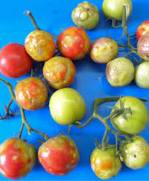
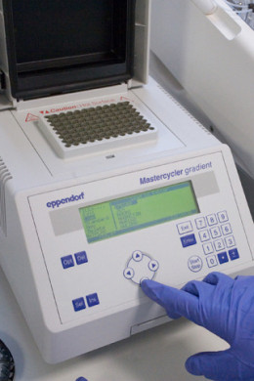
2025 Work Program Completed Project
Harmonization of diagnostic protocols for seed pests - ToBRFV
  Model for regional harmonization
    ToBRFV - quarantine pest for all NAPPO countries
    Host commodities - fruit, seeds and plants of tomato and pepper - heavily traded in our region
    Immediate benefits to regional trade
      Alleviating delays/costs resulting from conflicting seed test results
      Avoid unnecessary retesting
Source: CABI digital library

Slide 13
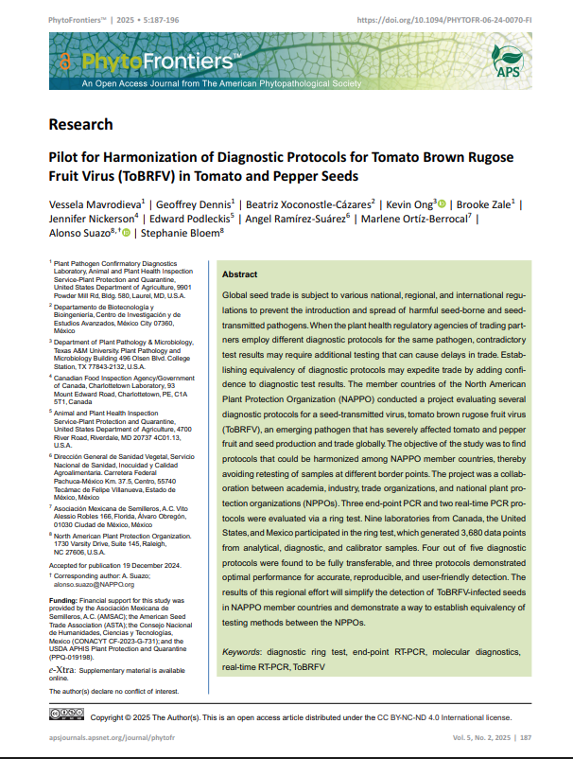
Updates
The manuscript “Pilot for harmonization of diagnostic protocols for tomato brown rugose fruit virus (ToBRFV) in tomato and pepper seeds” was published in the journal “PhytoFrontiers” (Mavrodieva et. al., 2025, 5(2); 187-196).
>1100 downloads

Slide 14
Recommendations (from EG final report)
Based on analysis of the ring test data, protocols A (CDFA), B (ISHI-Veg/NSHS), C ( USDA-APHIS-RT PCR), and D (USDA-APHIS- cPCR) produced comparable results and could be used interchangeably for the detection of ToBRFV in tomato and pepper seeds. They provide a choice between 2 real-time PCR and 2 conventional PCR methodologies.
Protocols B, C, and D performed optimally in relation to all assayed parameters and variables evaluated.
Furthermore, protocols B, C and D could be recognized by all three NAPPO member countries for phytosanitary testing of seeds for the presence of ToBRFV.
This will facilitate safe and expeditious trade of tomato and pepper seeds in our region and avoid unnecessary retesting by exporting and importing countries.
The experimental design used in this study can serve as a model for future studies to evaluate other diagnostic protocols for the detection of other seed-transmitted pests of regulatory significance.

Slide 15
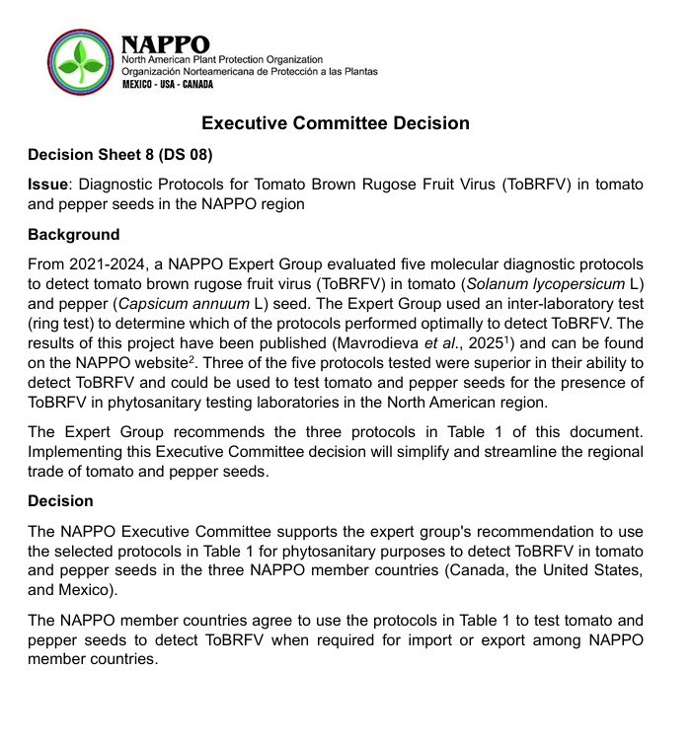
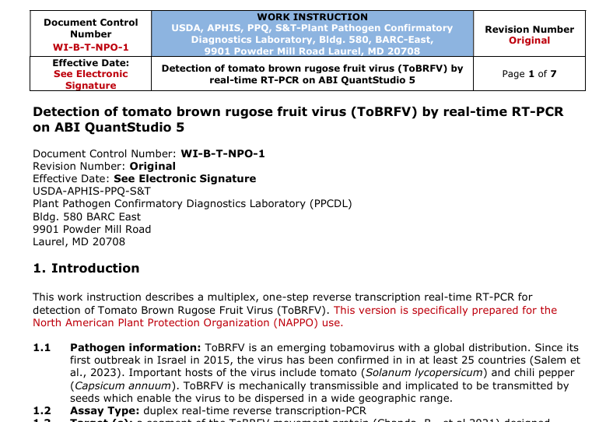
NAPPO Decision Sheet 08
The Executive Committee signed NAPPO DS 08, supporting the EG recommendation on the selected protocols for the identification of ToBRFV in tomato and pepper seeds.
Information on the selected protocols is available on the NAPPO website.

Slide 16
Thank you!

