Slide 1
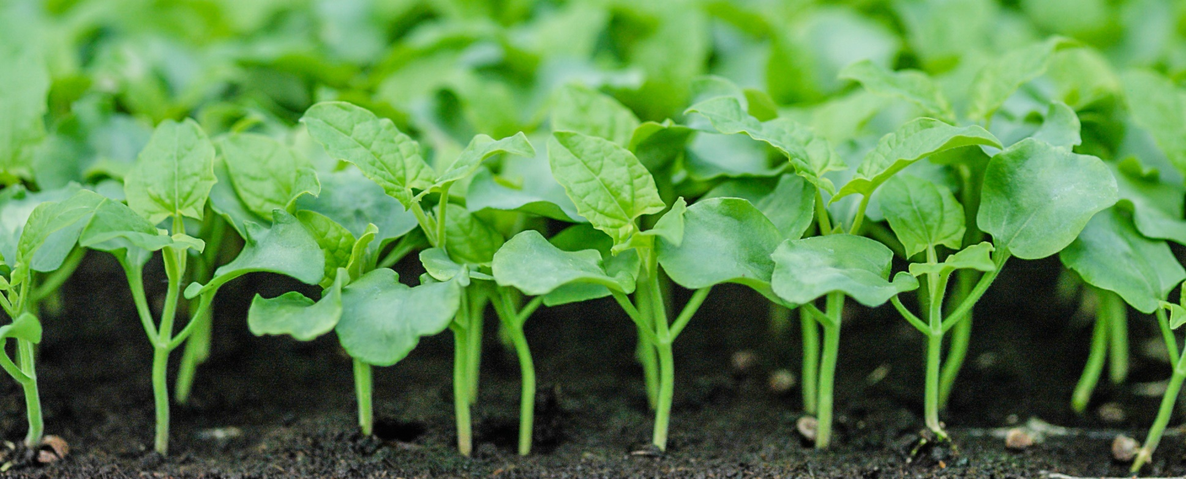
USDA Update
2025 NAPPO Annual Meeting
Matt Rhoads
Acting Deputy Administrator
Plant Protection and Quarantine
Notes:
Good afternoon. Buenos tardes.
I would like to thank you for the opportunity to provide the country updates on behalf of the United States.
Our previous PPQ Deputy Administrator, Mark Davidson, has retired, and I have the honor of serving as the acting PPQ Deputy Administrator.
I would first like to thank everyone joining us here today from the three NAPPO countries—the national plant protection organizations, industry, and our plant protection stakeholders.
And I also want to thank the NAPPO Secretariat for all the effort that goes into running the organization and putting on this meeting.
It goes without saying that we share a common interest---facilitating safe trade while protecting our respective countries’ agriculture.
It’s good to be able to get together with you again to talk about the work we are doing together and the work we still need to do.
This year has brought a lot of changes within USDA, and I would like to thank you all for your patience as we navigate the changes.
In PPQ, we continue to respond to pest outbreaks, run our standing domestic pest programs, inspect imported plants, manage phyosanitary trade issues, and work with US Customs and Border Protection on their part of our safeguarding mission.
We continue to participate in NAPPO and the IPCC, and cooperate with our core US stakeholders
But while we are still doing all of that, we are navigating organizational change.
The Trump Administration has made it a priority to reduce the size of the US federal workforce, and has been doing so in different ways.
Some US Federal agencies have experienced what we call reductions in force—where executive branch leadership reduces or eliminates certain programs or activities.
To date, USDA has not conducted reductions in force, but we have had a large reduction in staffing stemming from a voluntary deferred resignation program, where employees could elect to resign or retire in exchange for an extended amount of severance.
In most cases—these employees left service in May or before, but didn’t officially separate from the US Government until October 1.
In PPQ, this resulted in the loss of XXX staff from across the program.
While some functions were affected more than others, nearly every part of PPQ experienced some impacts from the DRP.
The Department has proposed a reorganization, with goals of ensuring the workforce aligns with financial resources and priorities, consolidating office space and relocating resources outside of the National Capitol Region, eliminating management layers and bureaucracy, and consolidating support functions.
A comment period for the reorganization ended in late September, and we are awaiting more information on what, if anything, those changes could mean for APHIS and PPQ.
While most of the Department and the Federal Government at large is not hiring, APHIS has several types of positions that are exempt from the hiring freeze, and we continue to prioritize hiring front-line mission critical positions, including those who do inspections and phytosanitary certifications.
We continue to adjust, and the changes are a work in progress.

Slide 2
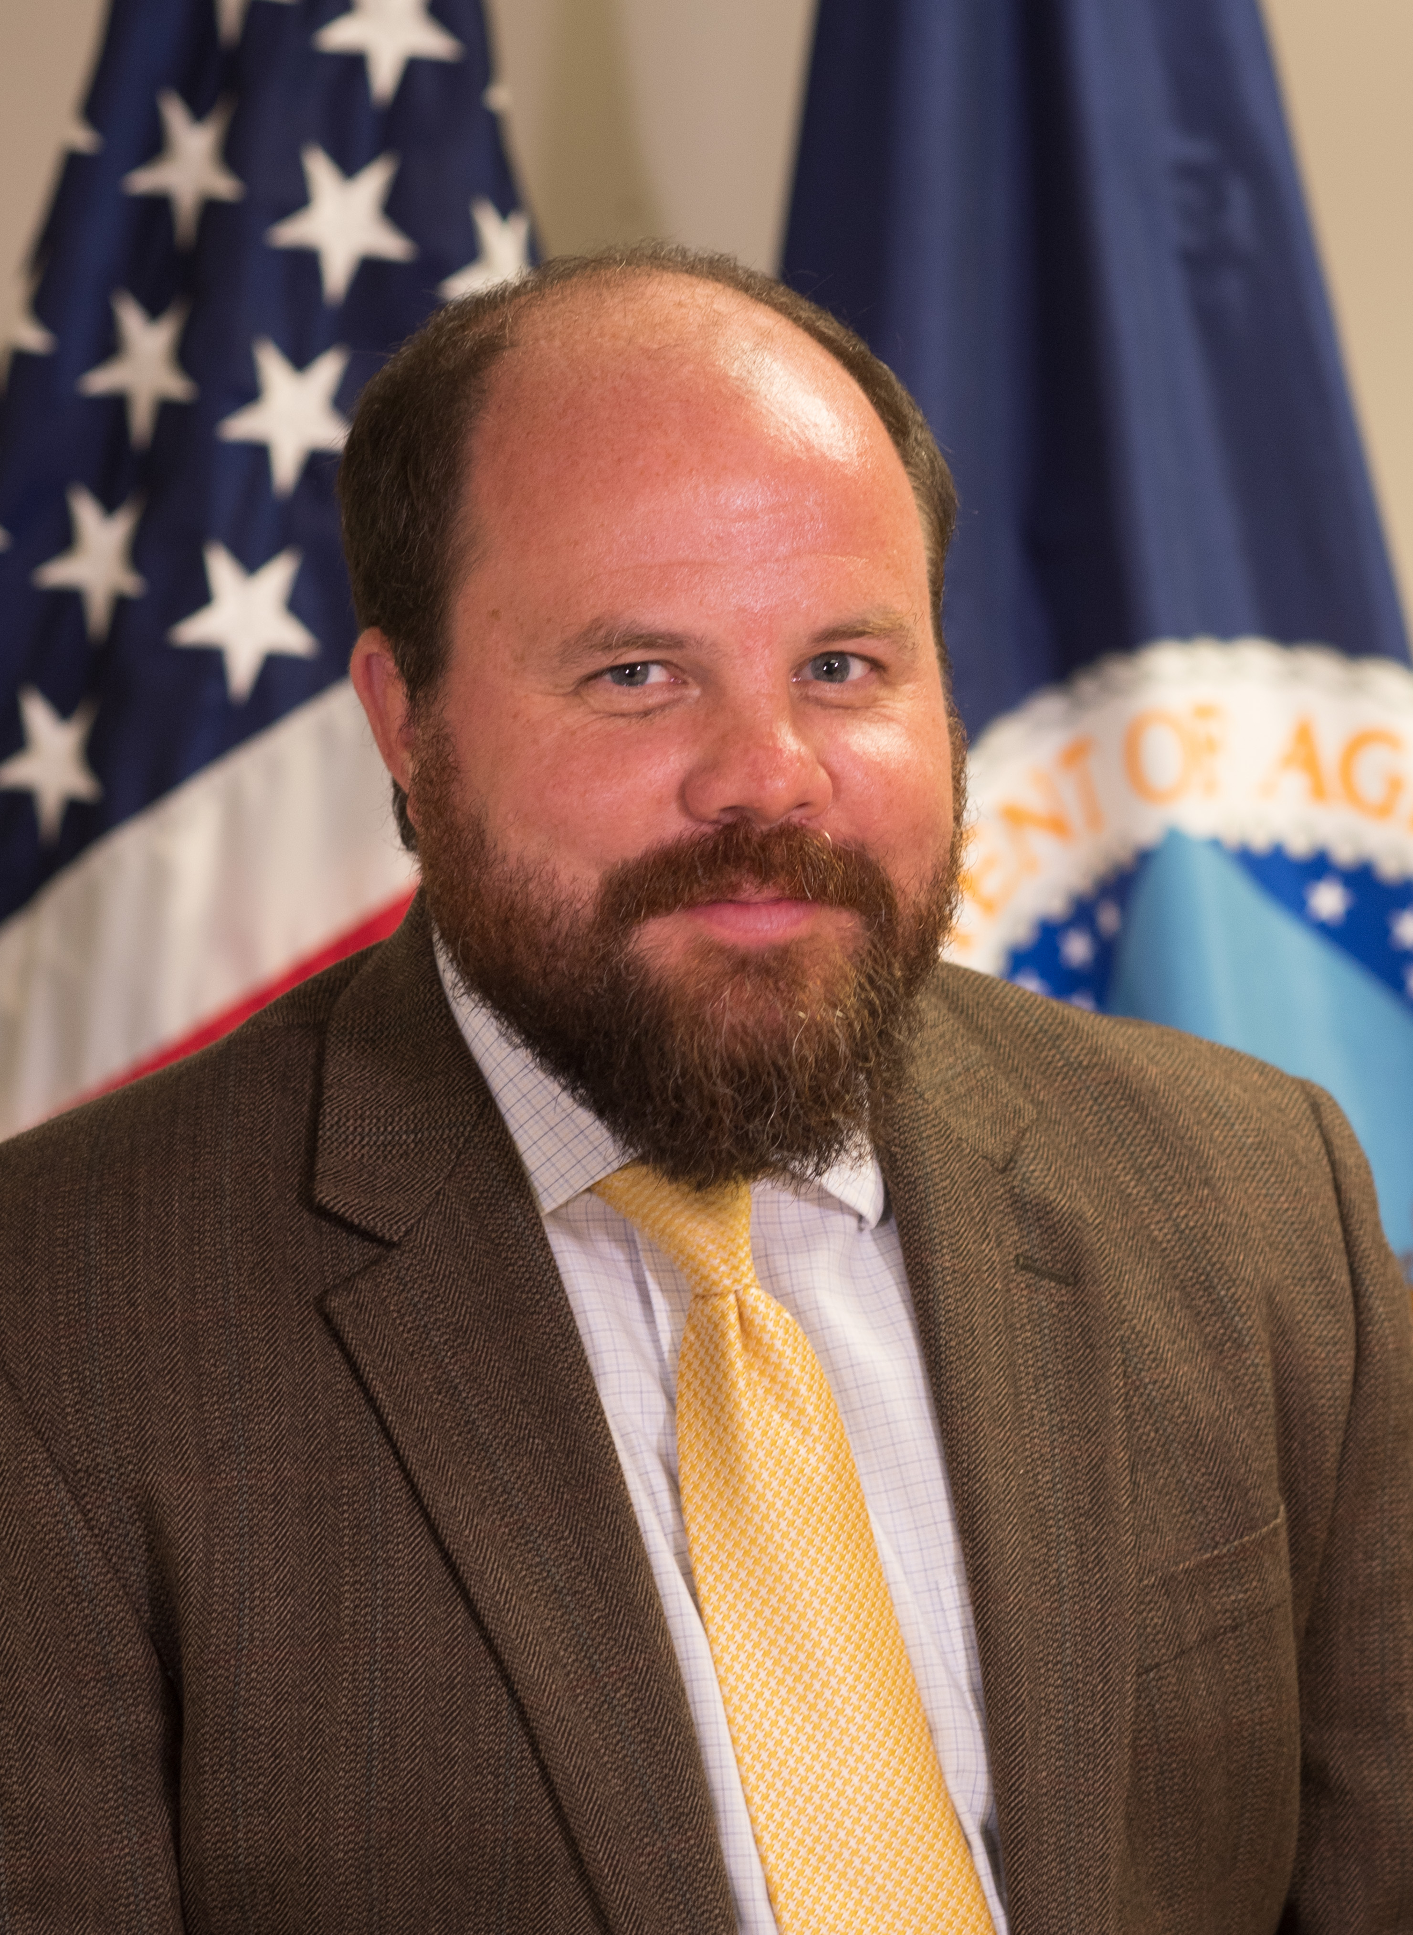
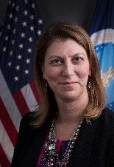
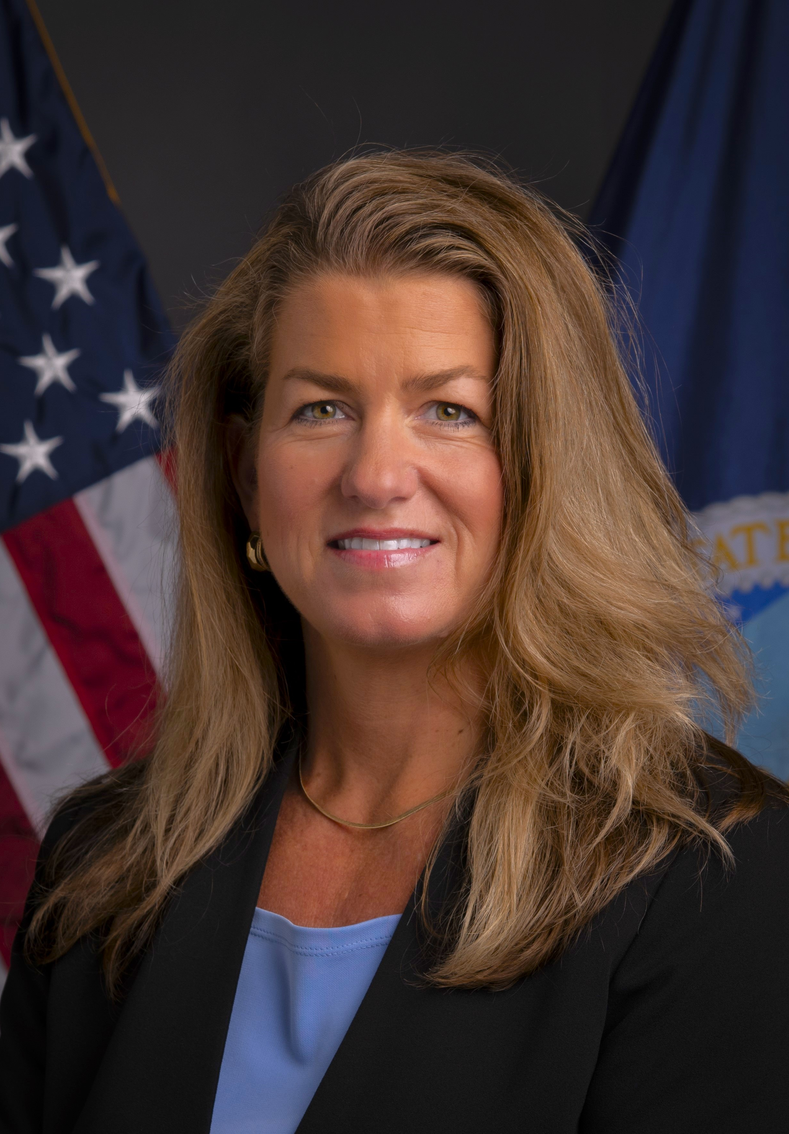
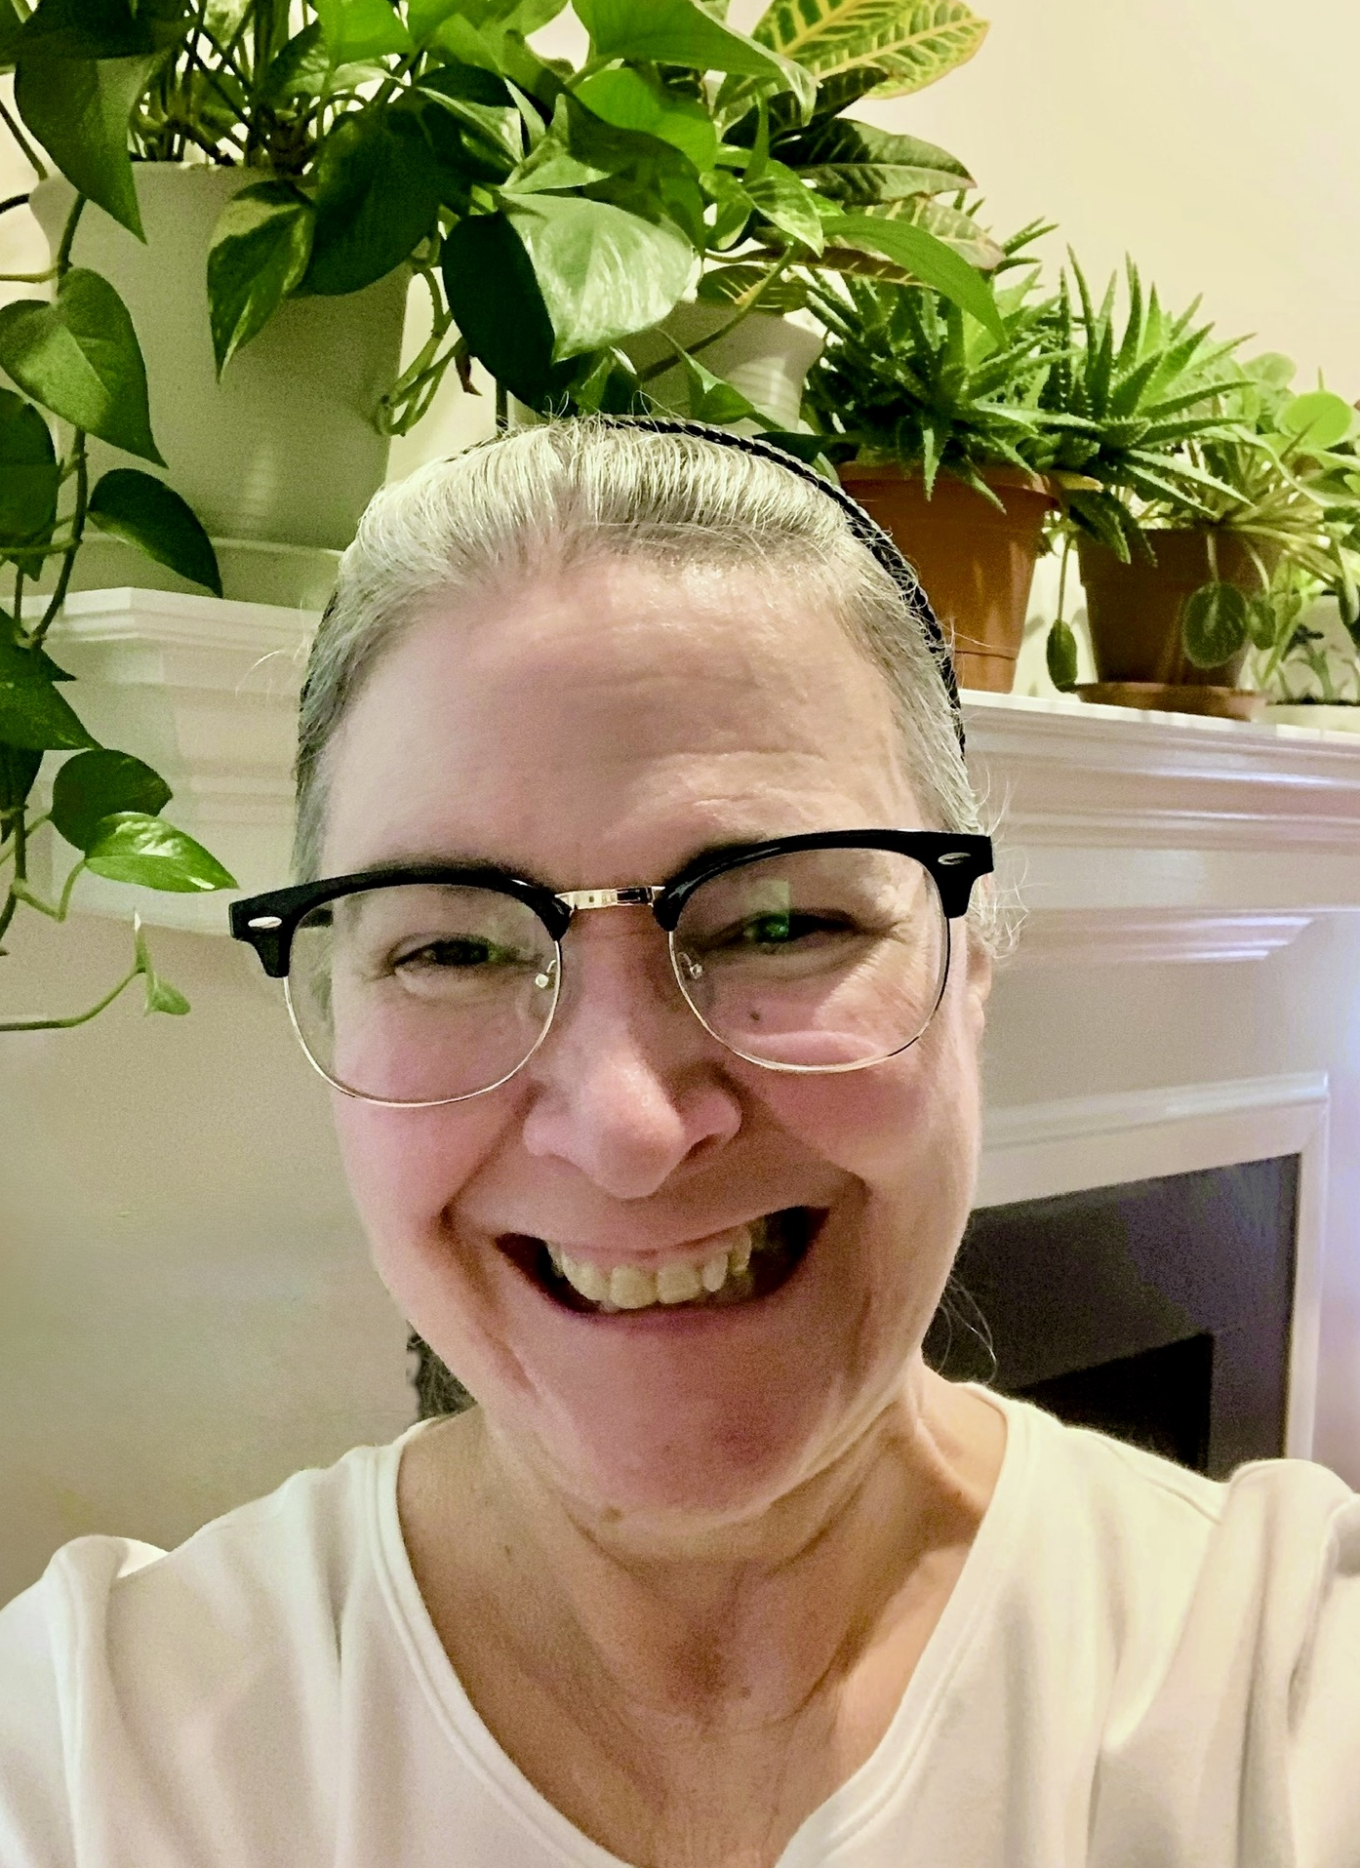
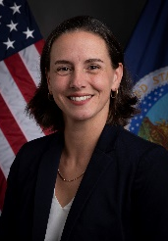
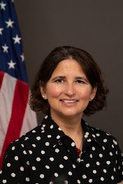
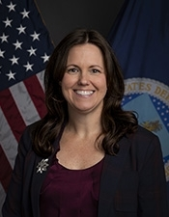
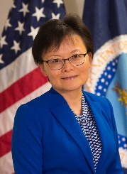
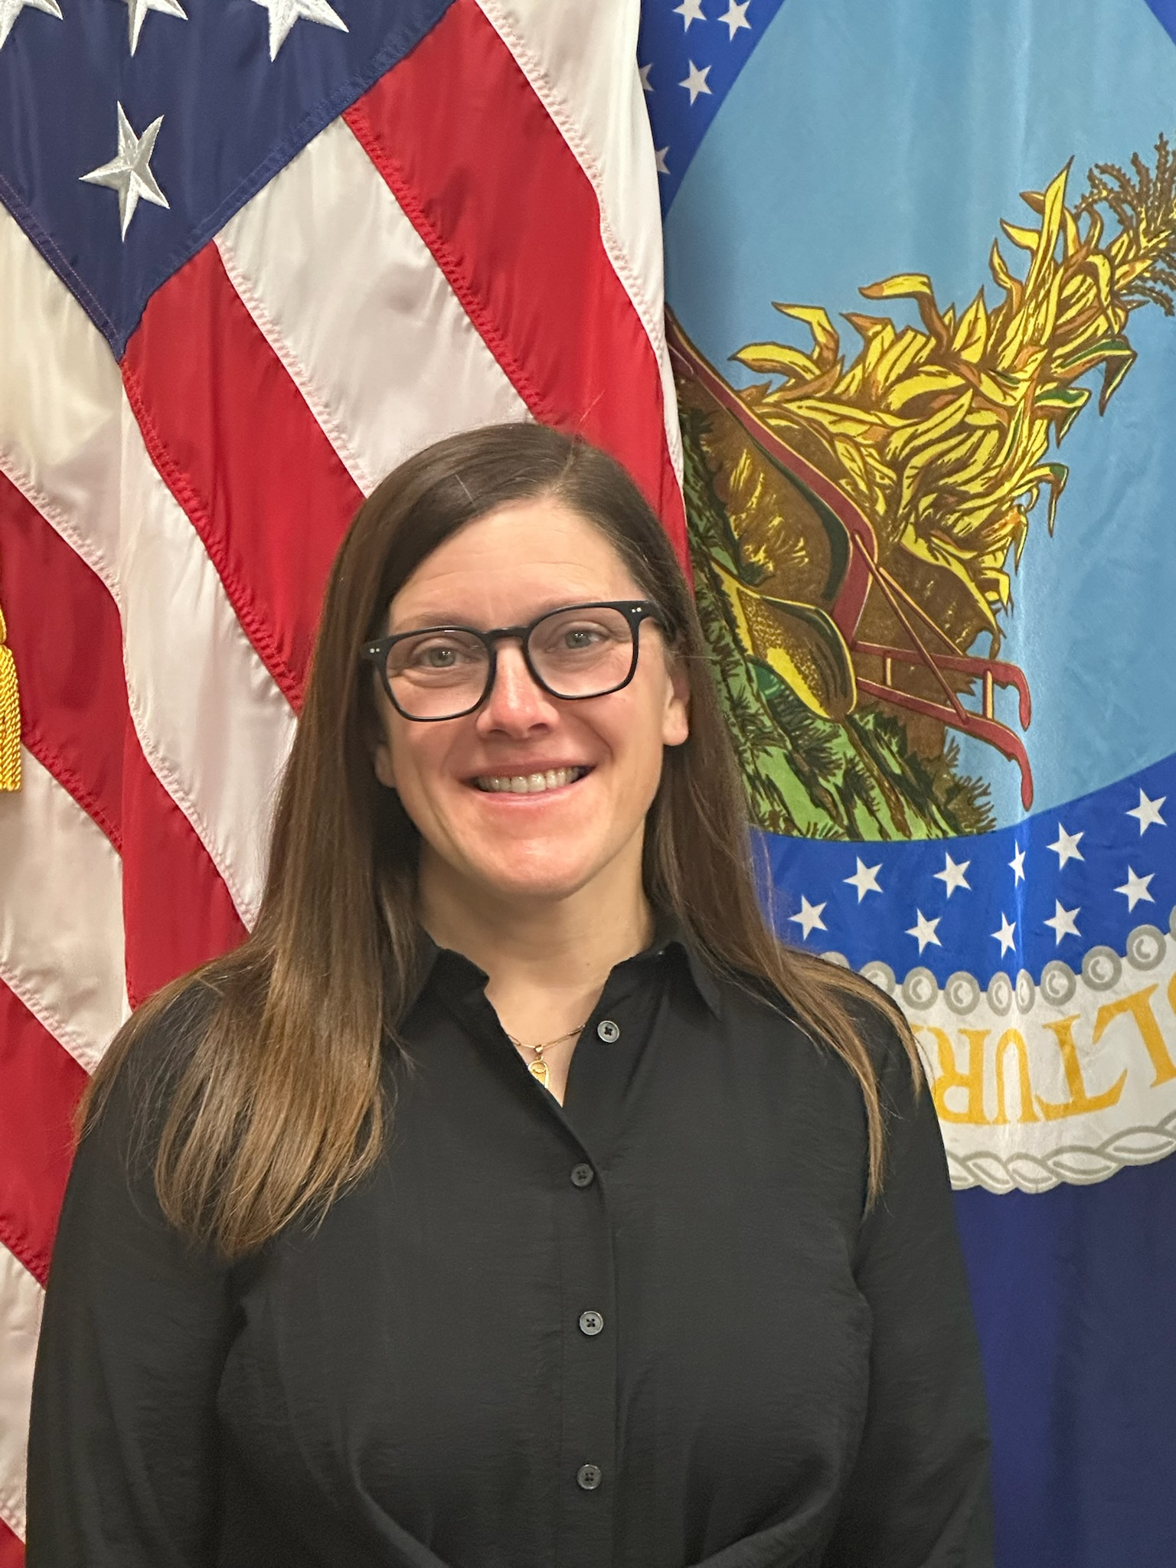
Leadership Changes
Plant Protection and Quarantine
Matt Rhoads
Acting Deputy Administrator
Samantha Simon
Associate Deputy Administrator
Business and Employee Services
Emergency and Domestic Programs
Field Operations
Int’l Phytosanitary Management and Standards Program
Pest Exclusion and Import Programs
Science and Technology
Carrie Thomas Associate Deputy Administrator
Jo-Ann Bentz Blanco
Acting Associate Deputy Administrator
Nicole Russo
Acting Associate Deputy Administrator
Jessica Mahalingappa
Associate Deputy Administrator
Abbey Fretz
Acting Associate Deputy Administrator
Wendy Jin Associate Deputy Administrator
Katie Hough
Acting Executive Director
Notes:
Slide 2: Leadership Changes
I mentioned Dr. Davidson’s retirement, but we also had two other retirements from the PPQ Management Team as part of the DRP—both of our Field Operations executives, Calvin Shuler and Carlos Martinez also retired--and we now have several acting leaders in place while the department determines leadership changes for the longer term.
Along with me assuming the acting Deputy Administrator position on the PPQ Management Team, we also have:
Jo-Ann Bentz-Blanco acting as Associate Deputy Administrator for Emergency and Domestic Programs.
Nicole Russo acting as Associate Deputy Administrator for Field Operations,
Katie Hough acting as Executive Director for Field Operations, and
Abbey Fretz is filling in behind me as acting Associate Deputy Administrator for Pest Exclusion and Import Programs.
Another critical leadership change for us is that our Undersecretary Mr. Dudley Hoskins, was confirmed by Congress and reported to the department at the beginning of October.
Mr. Hoskins serves as the head of Marketing and Regulatory Programs in USDA, which includes APHIS and the Agricultural Marketing Service.
This is critical appointment for APHIS who will help us clarify goals and objectives under the current administration.

Slide 3

Notes:
Slide 3: Budget
It’s hard to talk about the budget without acknowledging that most of the US Federal Government is shut down and does not have a budget in place for our fiscal year, which began October 1.
For APHIS, and PPQ in particular, we are fortunate in that many of our activities that support import and export are funded by user fees, which are not subject to appropriation by congress.
For the vast majority of other PPQ program activities that are funded with appropriations, employees are furloughed.
Some non-user fee funded employees continue to work on an ad hoc basis as critical or emergency issues pop up, but the majority will remain off work until a budget is passed.
We are optimistic that when a budget is passed, that the budget for APHIS will look not terribly different than FY25.
Between the president’s budget, as well as the house and senate markups, APHIS and PPQ’s appropriated budget, with a few relatively minor adjustments, should be flat.
In the current budgetary climate, that is a very good outcome for APHIS and for our plant health safeguarding mission.

Slide 4
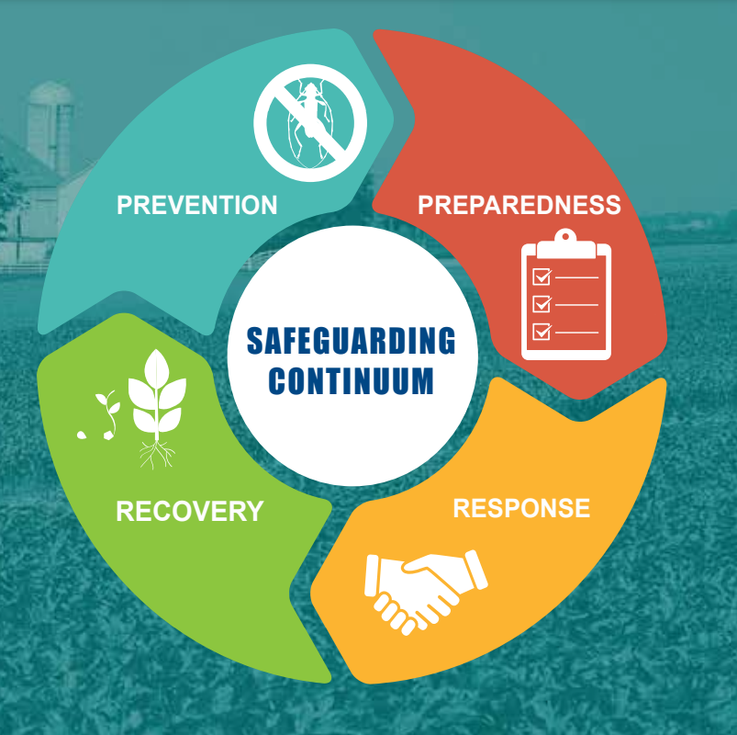
Plant Protection Act Section 7721
Increase from Congress for PPA 7721 from $75 million to $90 million in 2026
Continues to be a crucial funding source for our plant protection cooperators, including the States
Notes:
Slide 4: PPA 7721 Increase Funding and Open Period
I want to highlight another good news story here.
Earlier this year, the US Congress increased the Plant Protection Act section 7721 funding from $75 million to $90 million.
This funds the Plant Pest and Disease Management and Disaster Prevention Program (PPDMDPP) and the National Clean Plant Network (NCPN).
Under PPA 7721, APHIS offers funding for projects that enhance our ability to safeguard agriculture and facilitate safe agricultural trade.
Cooperators nationwide use this funding to:
Strengthen pest exclusion systems;
Optimize domestic pest management and eradication programs;
Keep commodities moving in commerce without spreading pests and diseases; and,
Expand market opportunities for U.S. products.
This work is critical to the USDA mission and helps American agriculture thrive.
This program is a powerful way to collaborate with the States and others in the plant protection community.

Slide 5
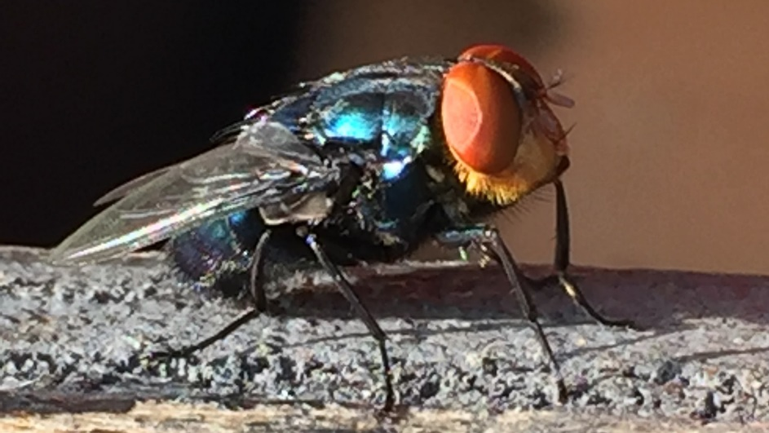
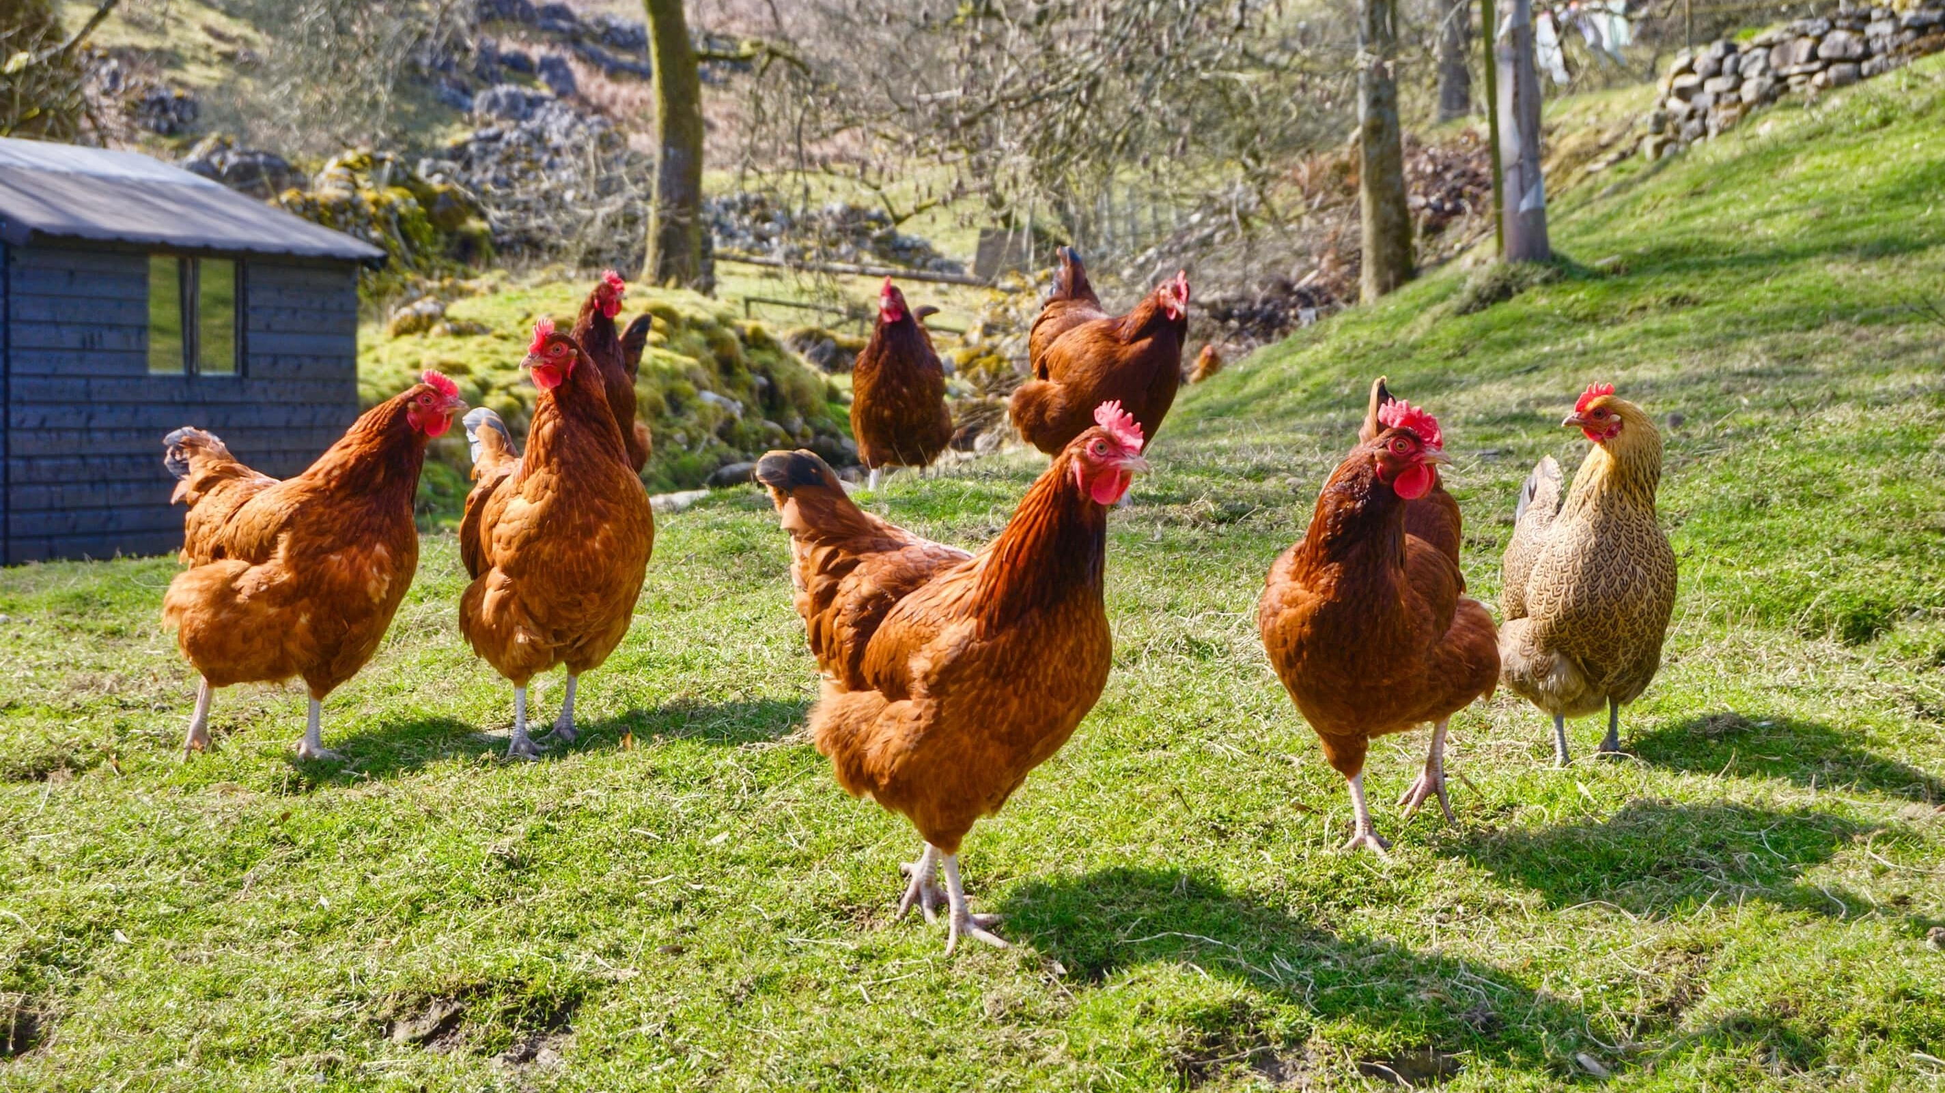
APHIS Priorities
High Path Avian Influenza (HPAI)
New World Screwworm
Notes:
Slide 5: APHIS Priorities
I also want to digress from our usual plant health focus for a few minutes and talk about animal health issues, because they have been such a high priority for USDA.
PPQ works closely with our Veterinary Services and International Services counterparts, especially during emergency outbreaks like those we are responding to for Highly Pathogenic Avian Influenza, and New World Screwworm.
While they are different pests and commodities than we typically work with, PPQ has a lot of experience managing pest and disease outbreaks, and our staff have been sent to assist with operations on the ground, including research, testing, and other control activities.
Highly Pathogenic Avian Influenza (HPAI)
HPAI is a highly contagious and deadly virus that primarily affects birds, but can also infect mammals, including humans.
APHIS works closely with States and the poultry industry to prevent avian influenza from becoming established in the U.S. poultry population.
In February 2025, the USDA launched a $1 billion plan to combat HPAI in the poultry industry.
This was on top of indemnity payments already being provided to farmers for culled flocks.
New World Screwworm (NWS, or Cochliomyia hominivorax)
The New World Screwworm is a species of parasitic blowfly whose larvae eat the living tissue of warm-blooded animals.
APHIS International Services (IS) maintains the only NWS pupae sterilization facility in the Americas.
The facility, located in Pacora, Panama, is jointly managed and funded by USDA and Panama’s Ministry of Agriculture Development through the Screwworm Barrier Maintenance Program (also known as COPEG).
COPEG produces, sterilizes, and releases NWS sterile flies in infested regions of Central America and Mexico.
The COPEG facility can produce over 100 million pupae per week during an outbreak event.
The USDA has committed an $850 million investment for fiscal year 2025 and beyond to combat the New World Screwworm, which includes $750 million for a domestic sterile fly production facility in the United States, capable of producing 300 million sterile flies per week to eradicate the pest.
The funding also supports technological advancements, international efforts in Mexico and Central America, and research into new prevention and control methods.
Managing these two pests remain major priorities for USDA.
Now I would like to talk about some progress we have made in some of our domestic pest management programs.

Slide 6
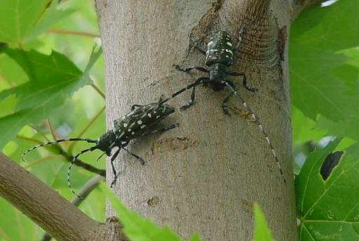
Asian Longhorned Bettle (ALB) Quarantine Removal
Removed 12.3 square miles of quarantine area in Worcester County, MA
The entire town of Holden, Massachusetts
Notes:
Slide 6: Asian Longhorned Beetle
APHIS, in partnership with the State of Massachusetts, removed the town of Holden, Massachusetts—a 12.3 square mile area in Worcester County—from the Asian longhorned beetle (ALB, or Anoplophora glabripennis) quarantined area.
This is a significant accomplishment for the State of Massachusetts and the program.
APHIS determined that this area could be removed from quarantine after completing final host tree surveys. With this removal, 97.7 square miles remain under Federal quarantine in Worcester County, including the northern portion of the Town of Auburn and the Towns of Boylston/West Boylston, Shrewsbury, and Worcester.

Slide 7
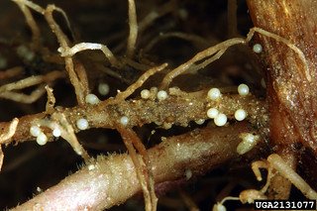
Pale Cyst Nematode (PCN) Quarantine Removal
First deregulation in program’s history
Removed over 50 acres from Bingham County, Idaho
Notes:
Slide 7: Pale Cyst Nematode (PCN) Quarantine Removal
For the first time in the United States, a field infested with the pale cyst nematode (Globodera pallida, or PCN) has been successfully cleared and deregulated.
More than 50 acres in Bingham County, Idaho, are now PCN-free, as they have been found to have completed the regulatory protocol for PCN eradication.

Slide 8
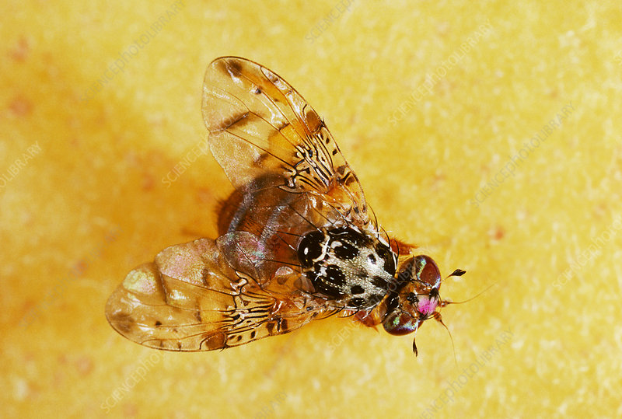
Fruit Fly Eradication & Suppression Successes & Challenges
By the end of summer 2025, California had no outbreaks under management for the first time since 2023.
New detections in California several weeks later. Medfly and Oriental Fruit Fly.
Continued management on Texas Border for Mexican Fruit Fly.
Fire at Moore Air Base Rearing Facility.
Notes:
Slide 8: Fruit Fly Quarantine Updates
Summer of 2023 saw a surge of invasive fruit fly species in California
Species included Oriental, Z. tau, Mediterranean, and Queensland Fruit Flies
By the end of July 2025, CA had no outbreaks under management for the first time since 2023.
But a few weeks later, we detected Medfly and set up a quarantine in Santa Clara County, CA, and then, a month after that, we detected Oriental Fruit Fly, which triggered a quarantine in Riverside and San Bernadino Counites.
So the work in California continues.
In fiscal year 2025, APHIS and the Texas Department of Agriculture responded to 10 concurrent Mexican fruit fly (Anastrepha ludens, or Mexfly) outbreaks, all but one of which have now been eradicated.
As for funding, in fiscal years 2024-2025, the USDA Secretary authorized the Commodity Credit Corporation (or CCC) emergency funds for eradication and prevention efforts totaling $232.6 million.
Significant CCC funds are being expended for facility modifications and transition to a male-only Mexfly strain to optimize sterile Mexfly supply in our Mexican Fruit Fly rearing facility Texas.
However, two weeks ago, we had a fire at our Texas facility, which impacts our ability to complete the full Mexican fruit fly rearing lifecycle.
As such, for the foreseeable future, we will be reliant on Mexican fruit fly pupae produced in Guatemala by the MOSCAMED program, to feed our sterile release program that protects our citrus in south Texas.

Slide 9
Plant Pathogen Diagnostics Certification Program (PPDCP)
Year 3 of program
Developed and produced the first ever lab methods proficiency testing
Completed annual interpretive proficiency tests for Candidatus Liberibacter asiaticus
Provided training to 80 diagnosticians
Notes:
Slide 9: Plant Pathogen Diagnostics Certification Program
This year, we wanted to highlight some of the work our Science and Technology branch does to support the entire PPQ mission - from pest exclusion and early detection, to emergency response and recovery, to domestic pest programs and international trade.
S&T’s Plant Pathogen Diagnostics Certification Program expands PPQ’s state of readiness to support new emergencies.
This is year three of implementing the program, and we are continuing to make improvements and develop proficiency testing.
The program developed and produced the first ever lab methods proficiency testing that addresses four crucial steps of diagnostics of multiple regulated plant pathogens: nucleic acid extraction, ELISA, and conventional and real-time PCR.
The program recently completed two annual interpretive proficiency tests for Candidatus Liberibacter asiaticus, the causal agent of citrus greening (huanglongbing), and plum pox virus, a regulated virus on stone fruit.
S&T also recently provided training on key molecular diagnostic techniques, general diagnostics, and regulatory processes to 80 diagnosticians from the National Plant Diagnostic Network, State Departments of Agriculture, and industry.
These efforts support PPQ’s mission by increasing PPQ’s diagnostic capacity to assist with plant health emergencies for high-consequence plant pathogens.

Slide 10
Pest Identification and Molecular Diagnostics
Developed or improved 45 molecular diagnostic methods
Developed a new assay that incorporates RPA and CRISPR-Cas detection into a single reaction for detection of R3B2
Evaluated digital PCR technology that provides a laboratory workflow of only 2.5 hours from sample to result
Notes:
Slide 10: Pest Identification and Molecular Diagnostics
S&T is advancing molecular diagnostics to support PPQ operations. Over the last year, S&T developed or improved 45 molecular diagnostic methods for plant pathogens or insects, including:
Phytophthora species
tomato leaf curl New Delhi virus
tomato brown rugose fruit virus
Cydia pomonella, or codling moth, and
Helicoverpa armigera, or Old World bollworm.
S&T also developed and validated several high-throughput sequencing methods for plant pathogens including:
Phytophthora species
Candidatus Phytoplasma species, and
Ralstonia solanacearum species complex.
S&T also developed a new assay that incorporates recombinase polymerase amplification, or RPA, and CRISPR-Cas detection into a single reaction for detection of the select agent Ralstonia solanacearum R3B2.
To reduce the number of inconclusive determinations and false negatives for various important pathogens, S&T evaluated digital PCR technology.
An extension of real-time PCR, this emerging technology provides a laboratory workflow of only 2.5 hours from sample to result, in addition to other advantages.

Slide 11
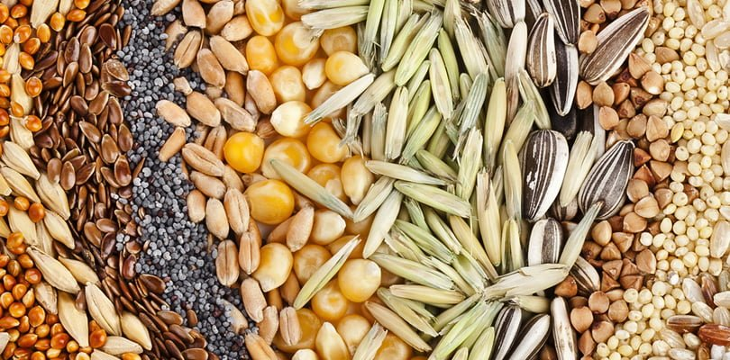
Fumigation and Alternatives
Continue to evaluate where we can reduce MeBr
Continue to use and evaluate new systems approach methods
Notes:
Slide 11: Fumigation and Alternatives
We continue to evaluate where we can reduce methyl bromide.
One proven, successful alternative we have is Systems Approaches, which we use during Pre-clearance and offshore, and in conjunction with other treatments, such as cold and irradiation.
We already have established agreements with Mexico, Thailand, and several other countries to combine Systems Approaches to reduce Methyl bromide.

Slide 12

Thank you!
Matt Rhoads
Acting Deputy Administrator
Plant Protection and Quarantine
Notes:
Slide 12: Conclusion and Thanks
We are honored to work with our dedicated Canada, and Mexico counterparts, our State partners, friends in industry, other plant protection stakeholders, and NAPPO, because together we accomplish many great things to protect plant health.
We are essential to each other’s mission, and every day, we safeguard our region’s agricultural and natural resources.
We keep the flow of exports moving, delivering tangible economic value to our Nation’s farmers, ranchers, foresters, and nursery growers.
I look forward to continuing and enhancing these essential partnerships.

