Slide 1

RNQPs in Practice: Sharing Lessons, Challenges, and Insights
Bruno Gallant, Canadian Food Inspection Agency
NAPPO Annual Meeting 2025 (October 22, 2025)

Slide 2
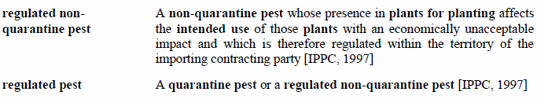
What is an RNQP?

Slide 3
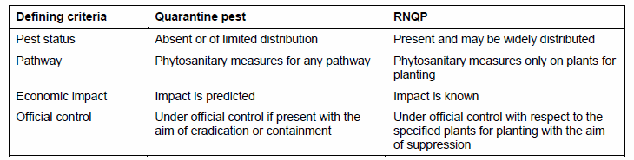
How do RNPQs compare to QPs?

Slide 4
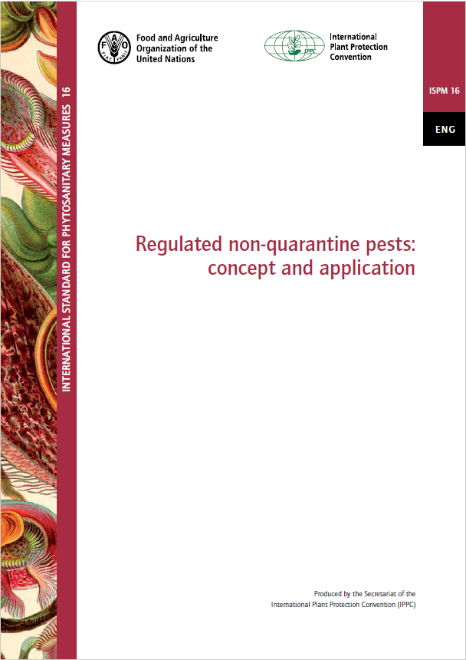
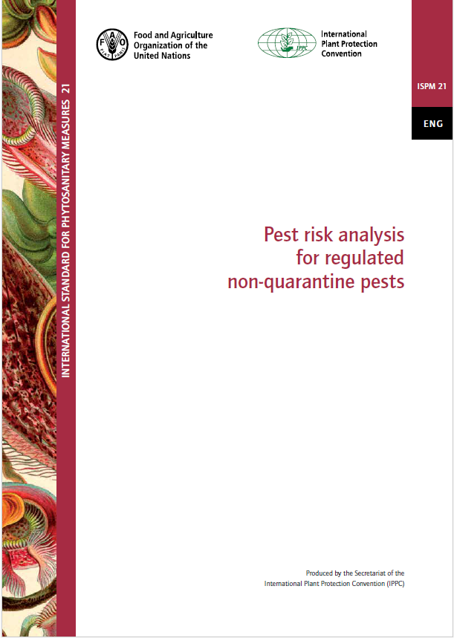

Slide 5
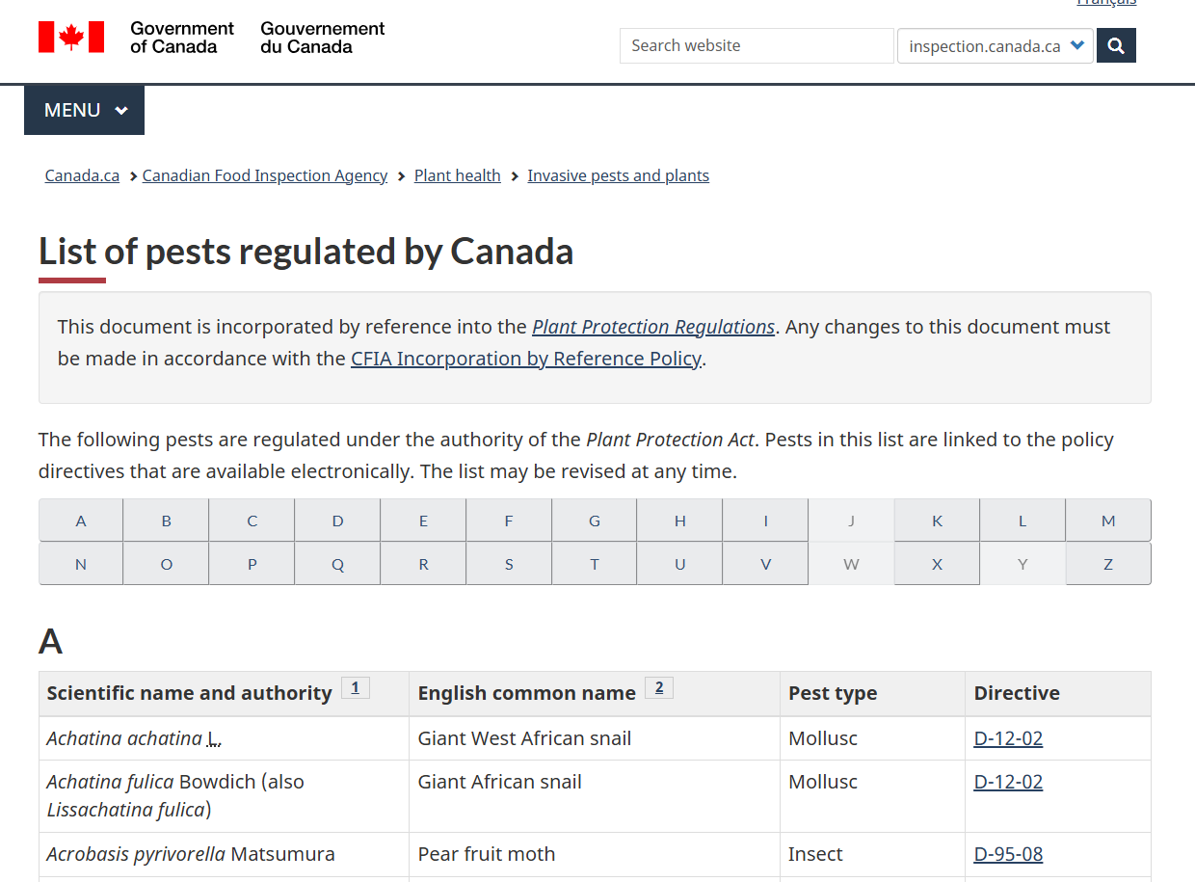

Slide 6
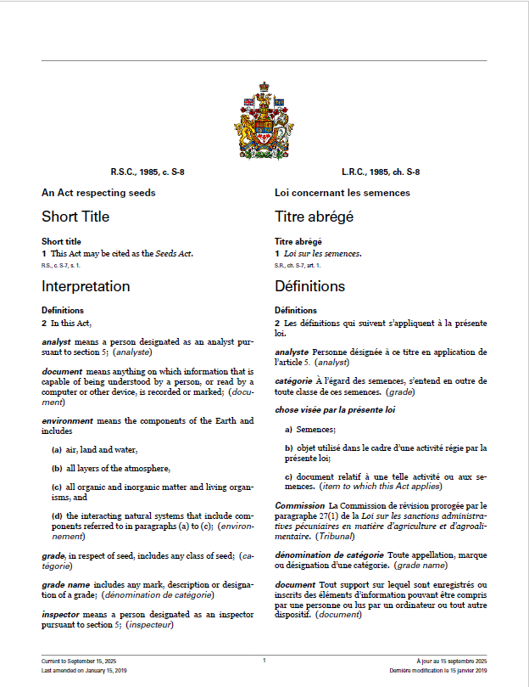
Seeds Act & Regulations
RNQPs for Seed: Weed seeds and fungi that affect the grading of certain species or crop kinds.
RNQPs for Seed Potatoes: Viroids, viruses, phytoplasmas, bacteria, and fungi that impact the classification of seed potatoes.

Slide 7
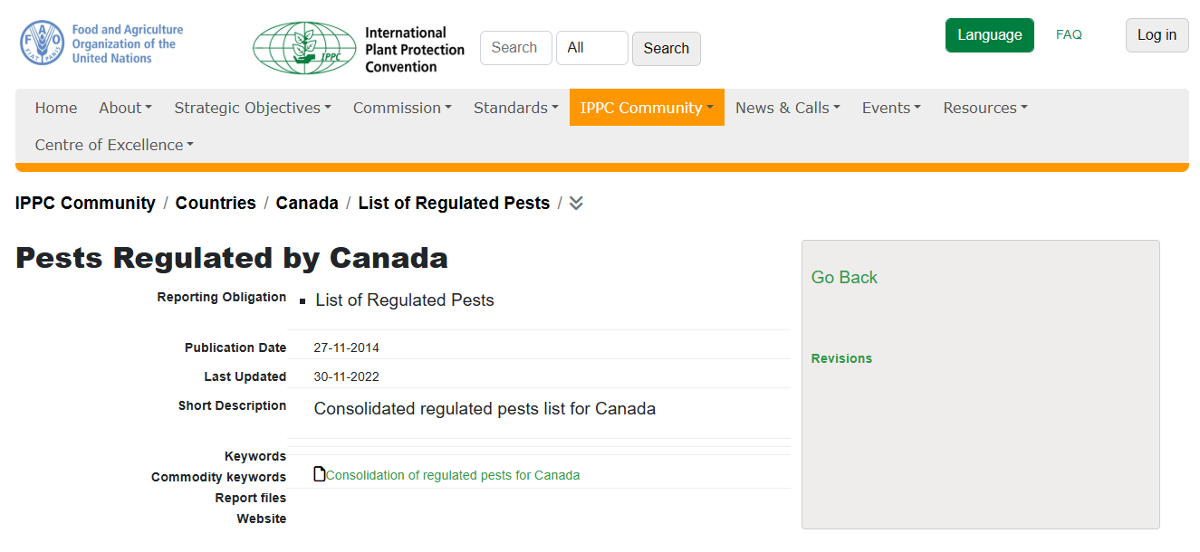
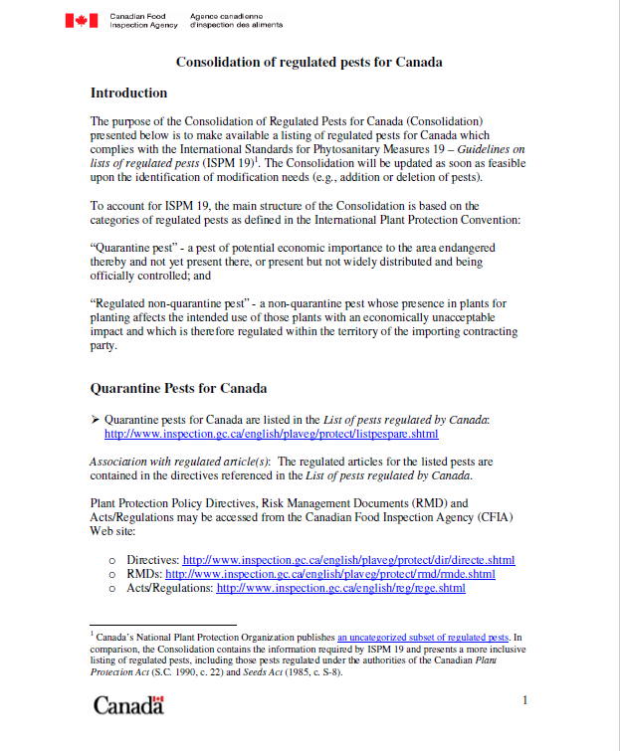
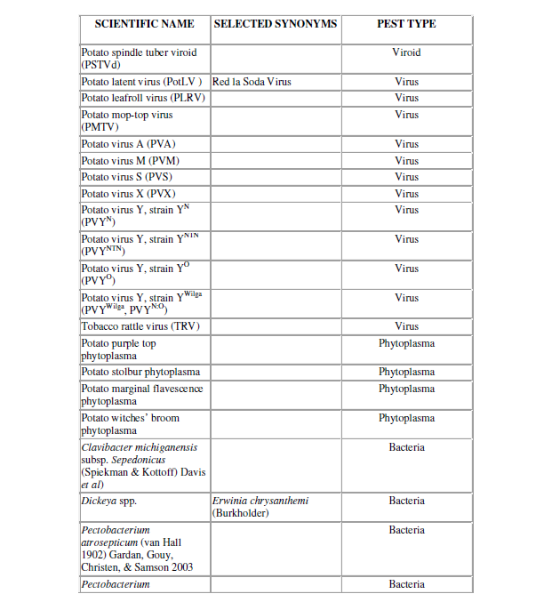
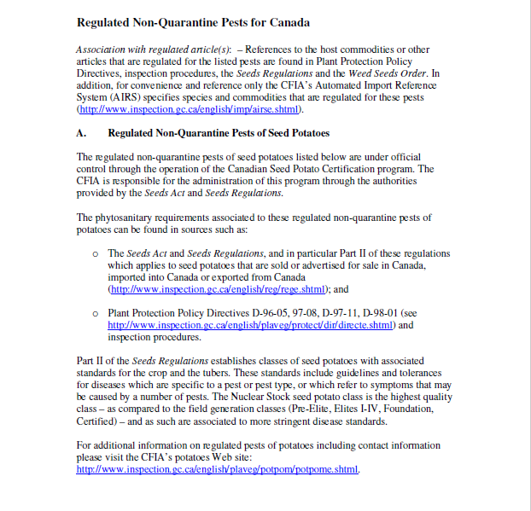

Slide 8
RNQPs: How should we approach their regulation?
Initiation points (ISPM 21):
  Plants for planting as a pathway
  Pest identification
  Policy review or revision
EU Project (2016): Developed recommendations for an initial list of RNQPs.
  Introduced a rapid assessment methodology, including a decision tree for analysis.

Slide 9
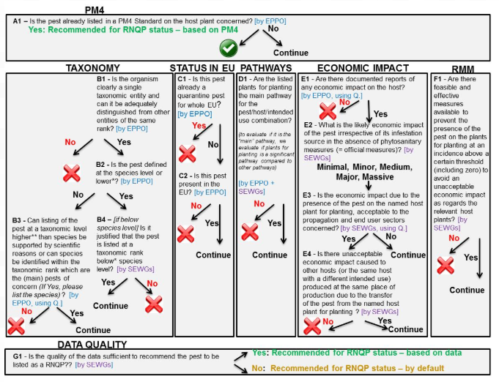

Slide 10
Thank you
  Lessons, Challenges, and Insights from within the NAPPO region?

